Slide 1

Group 11
Notes:
Brandon
Hello I’, brandon, yales, claire, luke, steffan. And Geng

Slide 2


1. What is
Procedurally generated exams Means you can practice as much or as little as you want
Simple As easy as any other question / answer website, except we never run out of questions.
For everyone Useful for professors, useful for students.
Notes:
brandon

Slide 3
FRONTEND

Slide 4

Users
Students
Course Reps
Professor
Admins
Notes:
CLAIRE:
Talk about each one, make it very clear that admins are us and why we need to define them! :)
Course reps are able to see statistics for all the modules they are a part of

Slide 5
Security and Business rules
Admins
12 characters
No words
None of the top 5000 passwords
Contains at least 1 special character
Contains at least 1 number
Contains at least 1 English letter
Notes:
geng
This is for administrator accounts
Administrator have stricter password requirements because if they are hacked they can delete the entire database

Slide 6
Security and Business rules
Everyone else
Be at least 8 characters long
Not in the top 5000 passwords
Not a single word
Not a sequence
Contains at least 1 special character
Contains at least 1 number
Contains at least one English letter
Notes:
Geng
Everyone else
Access to personal info
Admins have stricter password requirements
Only sending partial hash
Using have i been pwned api

Slide 7
Backup and recovery
Locally on server
Also backup to an overseas server.
Notes:
YALES
The backup procedure for the system will be split up into two ways. Firstly, Digital Ocean offers a backup solution on their own servers in Amsterdam. This will be the first backup, as it is physically and logically closet to our server it will be the fastest way to restore the system.
The second backup would be made by system administrators to another hard drive physically and logically far away from the datacenter in Amsterdam. This is because if an earthquake or some freak force of nature wipes out the datacenter in Amsterdam, it will not affect the United Kingdom. It is important to note that if you implement this system locally (IE not in Digital Ocean) or you live in Amsterdam it is important to backup away from the local hosting server.

Slide 8
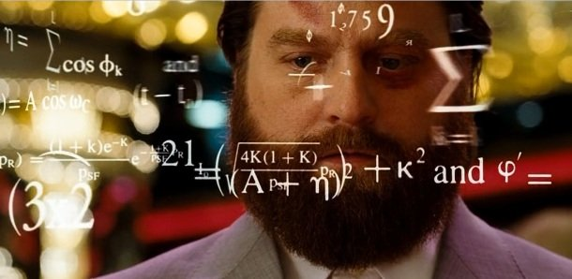
Competitors
MathGenMaker
Notes:
Brandon
In our requirements review, we mentioned that Khan Academy uses a similar algorithm to generate numbers for questions. Surprisingly, this isn’t true. Khan Academy relies on a plethora of volunteers to hand-write the numbers and answers for them, according to Khan Academy themselves.
Someone else had the exact same idea as us, MathTestMaker. Their program let’s people choose from a range of questions. Let’s explore it.

Slide 9
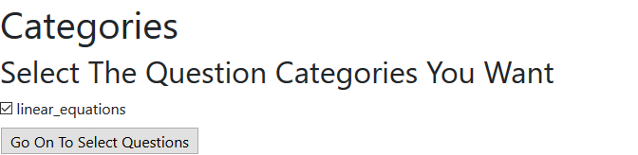
Notes:
Brandon
Their program let’s people choose from a range of questions:

Slide 10
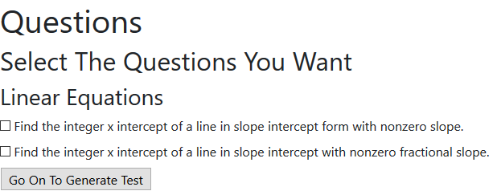
Notes:
Brandon
Their program let’s people choose from a range of questions:

Slide 11
“{'problemStatement': 'Find the x intercept of $y = -5x + -25$.', 'correctAnswer': -5, 'correctAnswerIdx': 3, 'wrongAnswers': [-4, -4, -4, -4], 'points': 1, 'solution': [('y = -5x + -25', 'Find the x intercept.'), ('0 = -5x + -25', 'Set y to zero.'), ('0 - -25 = -5x + -25 - -25', 'Subtract b from both sides.'), ('25 = -5x', 'Simplify.'), ('25 / -5 = x', 'Divide both sides by m.'), ('-5', 'Simplify.')]} “
Notes:
Brandon
While our ideas are similar, their code requires the programmer to have preemptively developed the questions and the format of the questions. This is very time consuming for the programmer. This project has existed for 2 years and it only has 1 type of question. It is not possible to add your own questions and add your own code from their interface. ExGen is designed to give freedom to the professor, not to take it away. While we are toying with the idea of having a similar solution where professors can choose questions which have already been made, it will not be the only thing the system will do. While the competitor MathTestMaker doesn’t let professors write their own questions or code, ExGen will.

Slide 12
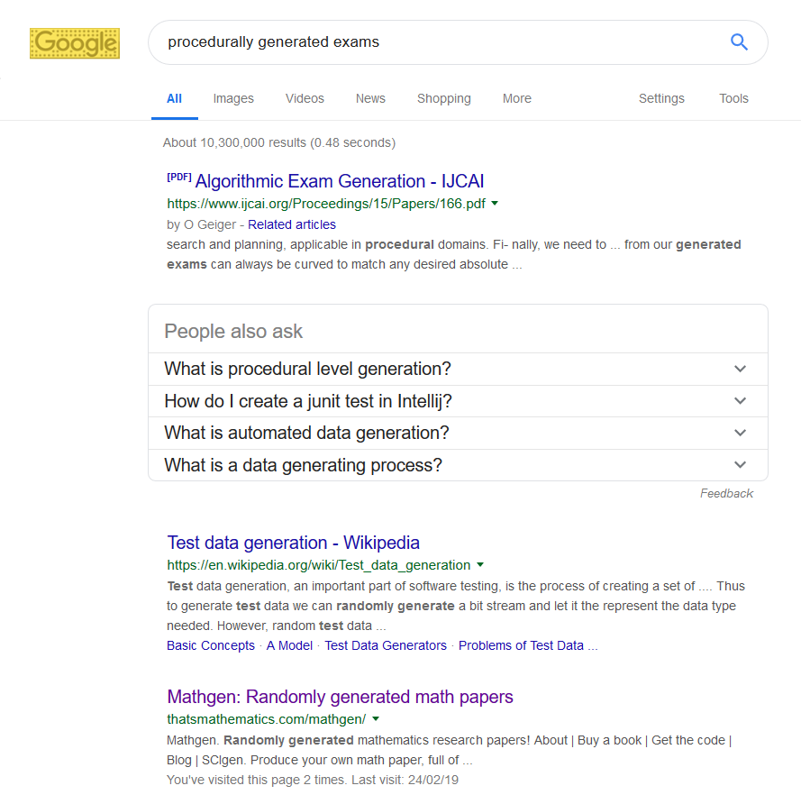

Notes:
Brandon
While our ideas are similar, their code requires the programmer to have preemptively developed the questions and the format of the questions. This is very time consuming for the programmer. This project has existed for 2 years and it only has 1 type of question. It is not possible to add your own questions and add your own code from their interface. ExGen is designed to give freedom to the professor, not to take it away. While we are toying with the idea of having a similar solution where professors can choose questions which have already been made, it will not be the only thing the system will do. While the competitor MathTestMaker doesn’t let professors write their own questions or code, ExGen will.
Algorithmic exam says
“Given a class of students and a pool of questions, what subset will constitute a “good” exam?”

Slide 13
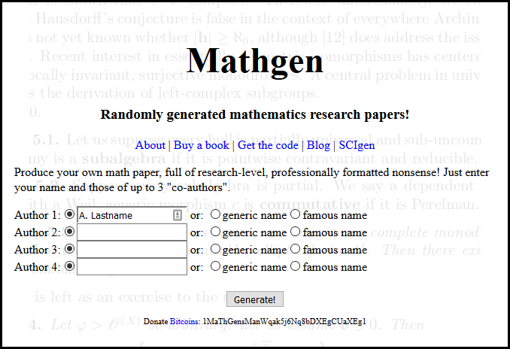
Notes:
Brandon
MathGen doesn't do what we do, they’re a joke. As you can see, there isn’t really any competitors to ExGen.

Slide 14
What we’ve done so far
This featured many changes. From our GitHub pull requests:
Allow for hidden constants. This allows the user to specify a number between {min = x} and {max = y}.
Refactoring the code to Object Oriented Design
Allow spaces in the hidden constants definition (bug fix).
Allow the user to enter any question they want, one of the largest features we shipped. Now the user can enter a question and the program will work no matter the question (as long as its maths / computer science).
Allow multi-character variables. Users can now do things like “What is firstNumber + lastNumber {min = 5, max = 25}”
Refactor the code to feature PEP8, the Python style guide.
Make constants optional in the program. So users do not have to enter min, max if they want to. These numbers are randomly select.
Notes:
Yales
Version 2.0 of ExGen!
We’ve allowed the user to seet paramemters for their questions, this is explained later.
at the end talk about how you can see thid in ab example later oj wyeb we demo exgen

Slide 15
What we’ve done so far
Created a fully fledged design
Luke and I created and coded a design using Figma, an online design / storyboarding tool. Thanks to their efforts, the design of the website is finished. As you will see in the design presentation.
Notes:
Steffan
<point at luke>
LUKE AND I
Created an interactable interface using an online program called figma. Figma is a drag and drop design/interface maker. The reason we went with figma is that you can download the functioning code for the interface and implement it in our final system system. We have a working demo for students, course reps and profoessors later on.

Slide 16
What we’ve done so far
Set up the server with all the software we need, and writing Monitor Bot and backup Bot.
Steffan, Geng and Brandon did this. We set the server up as described in the requirements document:
Ubuntu on Digitalocean
Cloudflare CDN
Apache web server
Mysql database
Wrote Monitor & Backup bot
Set up ZSH
Installing Python
Setting up PHP
.
Notes:
Brandon

Slide 17
What we’ve done so far
Designed and created the database
Claire created the database and designed the tables. Everything related to databases she has done. Some of the notable feats are:
Setting up the database
Creating tables
Entity Relationship Diagram
Logical Table
Transaction Matrix
Designing some transactions
Notes:
claire

Slide 18
What we’ve done so far
According to our Gantt chart, GitHub issue resolution (on average it takes 4 days for an issue to be fixed) and all the work put in by our team, we are on a good trajectory to finishing this project
Notes:
geng

Slide 19
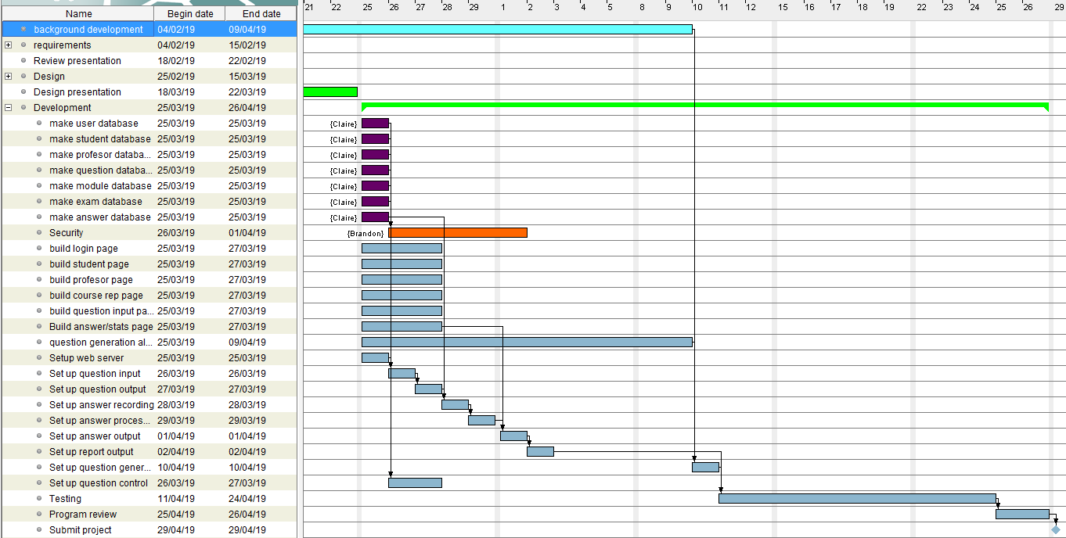
Gantt chart (what we are planning to do)
Notes:
Geng

Slide 20
Risk Assessment
The risks for our system can be broadly categorised into 2 main groups:
Risks for the system:
Server failure (low)
Server breach (low)
Misuse/cheating by user (low)
Risks for the project:
Running out of resources (low)
Server failure (low)
Meeting deadlines (low)
Notes:
Geng

Slide 21
INTERFACE DEMO
Notes:
Professor: https://www.figma.com/proto/0l7rHwP5jm5Ww2tj0KjtWeXM/ExGen-Professor?node-id=1%3A29&scaling=min-zoom Course Rep: https://www.figma.com/proto/BggxfFF0mHsQUIWP16Q5XhBP/ExGen-Course-Rep?node-id=0%3A1&scaling=min-zoom Student: https://www.figma.com/proto/gD7GD9E2xvF4eRZeAlFqg3sz/ExGen?node-id=0%3A1&scaling=min-zoom
Register
Password like we mentioned before needs to be secure GBA
Skip question has not been implemented yet but will be added
You will see average of all exams as well as each individual in a further breakdown
Added timestamp and search code
Whole values will be changed
Question preferences will be gone from students
Rep goes to pro, pro goes to admin

Slide 22
Evaluation Design
When evaluating our design we are focusing on satisfying 6 specific factors.
CLARITY
CONSCIOUSNESS
DETECTABILITY
CONSISTENCY
COMPREHENSIBILITY
LEGIBILITY
Notes:
steffan
Explain each of these 6 factors

Slide 23
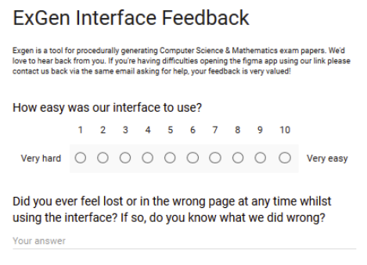
How did we evaluate?
We provided our Figma build to a test group consisting of a wide spread of ages with varying technological skills. They were then asked to complete a survey, providing feedback on our interface. With the questions in the survey aiming to provide direct feedback relating to the 6 test factors.
Notes:
Luke
The group consisted of Friends from other course, roommates, family and online friends.

Slide 24
Findings of our survey
Positives
Accessible
No one felt lost within our system
Information easy to find
Easy to use
Technological experience not necessary
Constructive Criticism
Lacks a little originality in terms of the interface design
(time constraints)
Notes:
Luke

Slide 25
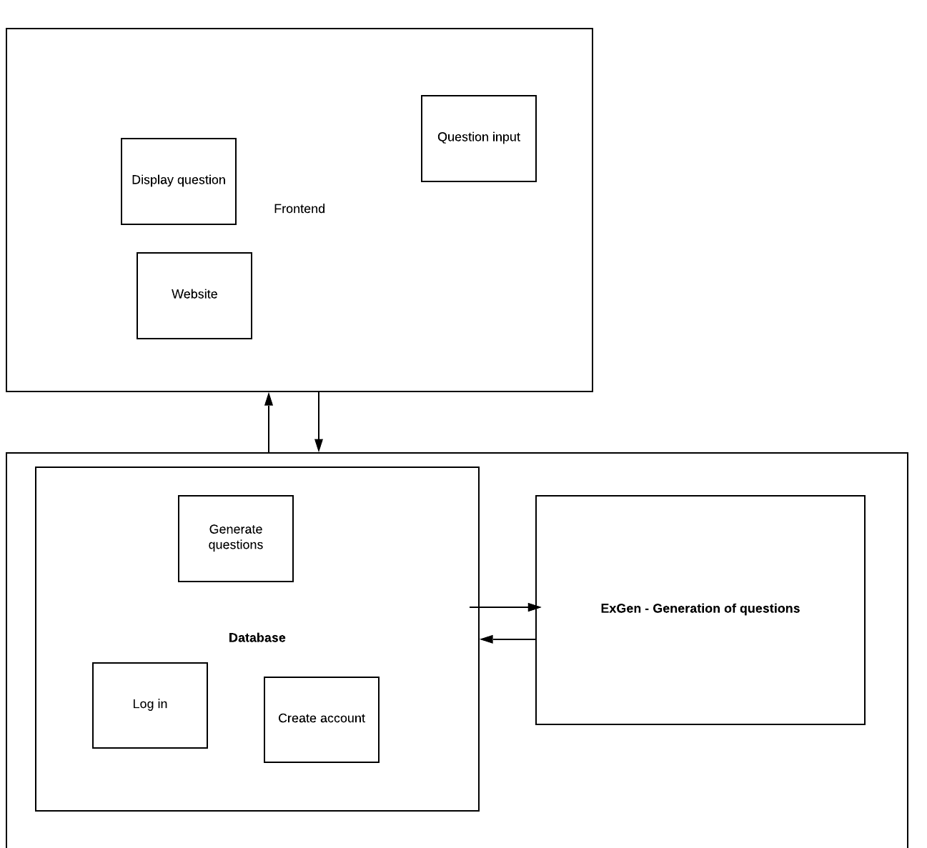
Subsystem Design
Notes:
Brandon
The frontend will have 3 main subsystems. Display question, the website itself and an input form so the professor can input questions.
When a professor writes a question, it gets sent to the database through a pre-configured SQL Transaction. When a student loads an exam, the questions to that exam will be quired to the database using a pre-configured SQL transaction. If the database does not have the question for that exam, it asks ExGen to generate the question.
ExGen will then send back the generated question to the database. The database then sends it to the frontend for the user. No user in our system has direct access to the database apart from the administrators, who maintain the system.
The server has 3 robots to help maintain it. The security bot was talked about in our requirements document. It maintains the security of the system. If the professors code takes too long to execute, it ends that thread and informs the professor of an error.
The monitor bot is only partly hosted on our system. It has a sister monitor bot on another server. If these two bots do not talk to each other, then the server is presumed to be down. It checks every minute to make sure the system is operational.
The backup bot backs up the database locally, and then again to an overseas server.

Slide 26
USE-CASE DIAGRAM

Slide 27
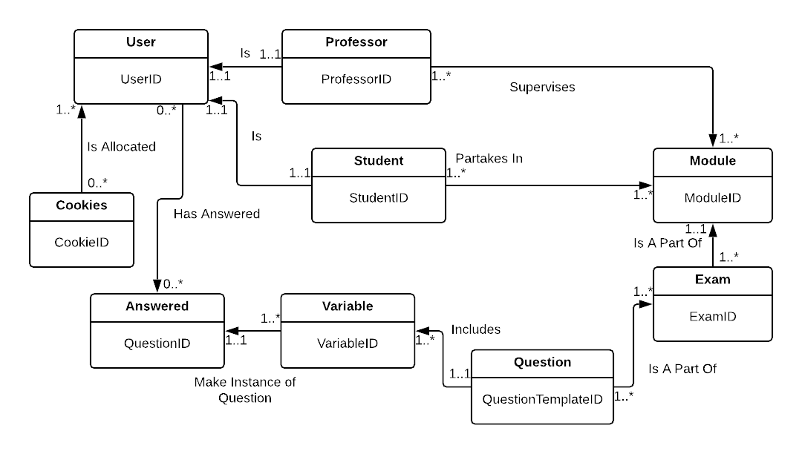
Entity-relationship diagram
Notes:
Claire

Slide 28
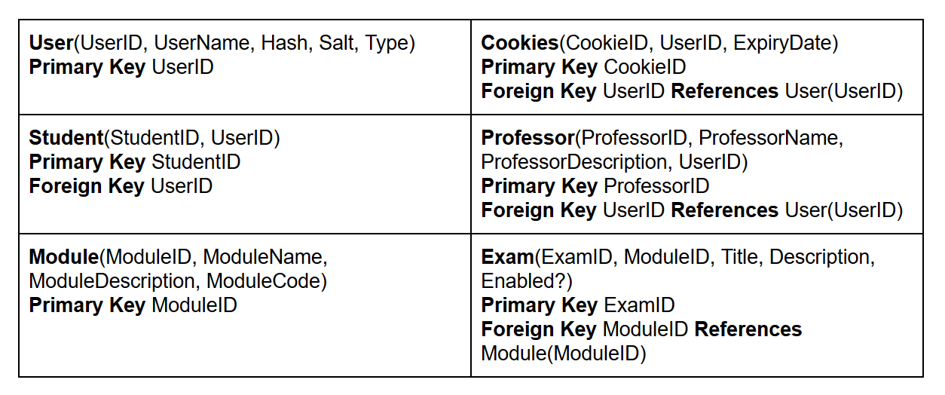
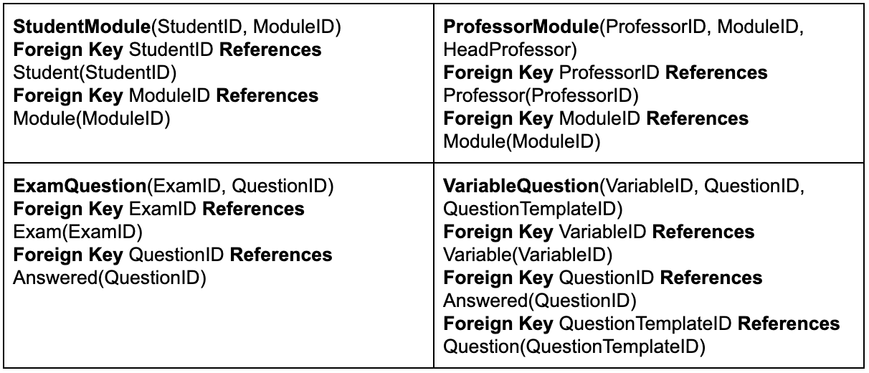
Logical table structure
Notes:
Claire
As you can see from pages 42 and up, these are the logical table structure.

Slide 29
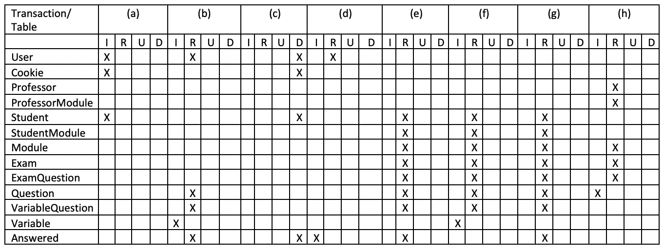
Transaction matrix
Creation of a student account
Creation of new questions, once the pre rendered ones have been exhausted by a student
A student deletes their account
A student completes a question
A student requests their own statistics for a module
A student queries for a new exam question to complete
A Course Representative requests an overview of the statistics of an exam
A professor adds new questions to an exam
Notes:
Claire
The frontend will have 3 main subsystems. Display question, the website itself and an input form so the professor can input questions.
When a professor writes a question, it gets sent to the database through a pre-configured SQL Transaction. When a student loads an exam, the questions to that exam will be quired to the database using a pre-configured SQL transaction. If the database does not have the question for that exam, it asks ExGen to generate the question.
ExGen will then send back the generated question to the database. The database then sends it to the frontend for the user. No user in our system has direct access to the database apart from the administrators, who maintain the system.
The server has 3 robots to help maintain it. The security bot was talked about in our requirements document. It maintains the security of the system. If the professors code takes too long to execute, it ends that thread and informs the professor of an error.
The monitor bot is only partly hosted on our system. It has a sister monitor bot on another server. If these two bots do not talk to each other, then the server is presumed to be down. It checks every minute to make sure the system is operational.
The backup bot backs up the database locally, and then again to an overseas server.

Slide 30
Sequence Diagrams
Notes:
brandon
First one
The first sequence diagram is a typical converstation in our program.
Second one
Above is a professor:
Registering for the system
Confirming they are a professor
Making a module
Assigning a professor to that module
Assigning a course rep to that module
If the student has been verified as course rep (by a professor) then any modules they are assigned to they will automatically become course reps.
Third one:
Here are course reps requesting to see the global report of a module. A professor can do the same. Course reps are normally assigned by professors, as talked about in the requirements document.

Slide 31
BACKEND

Slide 32
What is $term1 + $term2 equal to? {maxbound = 20}
variable
variable
constant
Notes:
Psuedocode in the document

Slide 33
What is $term1 + $term2 equal to? {maxbound = 20}
term1
term2
maxbound
20

Slide 34
getRandomInt(min = 1,
max = maxbound)
term1
10
term2
15
maxbound
20

Slide 35
sum(term1,term2)
25
TRUE
term1
10
term2
15
maxbound
20

Slide 36
generateWrongAnswers(rightAnswer)
25
TRUE
term1
10
22
FALSE
term2
15
19
FALSE
maxbound
20
31
FALSE
27
FALSE

Slide 37
What is + equal to?
$term1
$term2
{maxbound = 20}
10
15
25
TRUE
term1
10
22
FALSE
term2
15
19
FALSE
maxbound
20
31
FALSE
27
FALSE

Slide 38
What is 10 + 15 equal to?

Slide 39
What is 10 + 15 equal to?
a) 25
b) 22
c) 19
d) 31
e) 27
25
TRUE
22
FALSE
19
FALSE
31
FALSE
27
FALSE

